Slide 1
Overall look at the project's pages
Add New Device, Device Settings and Timing Settings

Slide 2
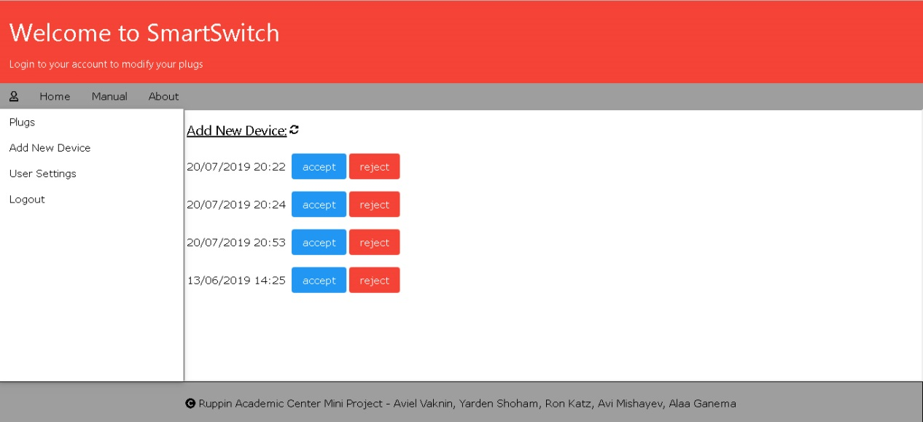
Add New Device

Slide 3
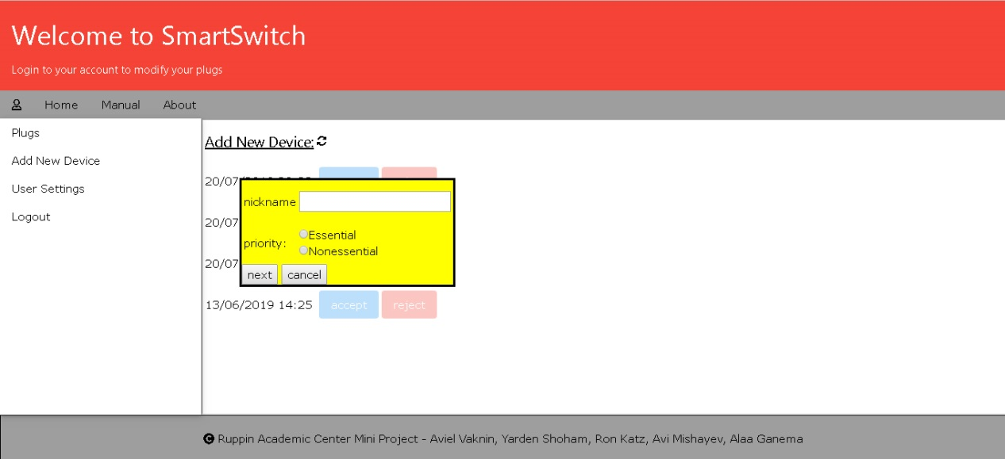
Add New Device

Slide 4
Add New Device
Page elements and functionalities:
Present all unapproved plugs for the client as viable options
An “reject” button, which removes the unapproved plug as viable option for the client
Present a popup by choosing a certain unapproved plug, by clicking the “accept” button
Using said popup, the client determines the settings of the chosen plug
Conveying the client’s choices to the database and updating the page accordingly by clicking the “next” button from the popup
Removing the popup by clicking on the “cancel” button ,which is located on said popup
A “refresh” button, which loads the page on click

Slide 5
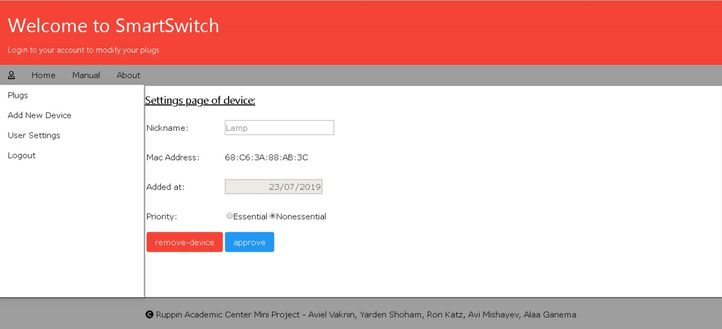
Device Settings

Slide 6
Device Settings
Page elements and functionalities:
Present the current settings of the chosen plug, including the date of its arrival to the database and it’s mac address (which are unchangeable)
An option to change the current nickname of the chosen plug
An option to change the current plug’s priority
An “approve” button, which conveys the client changes to the database
An “remove-device” button, which removes the chosen plug from the client’s approved plugs, removes the plug from the database and updates the page accordingly by returning to the plugs Main Viewer page

Slide 7
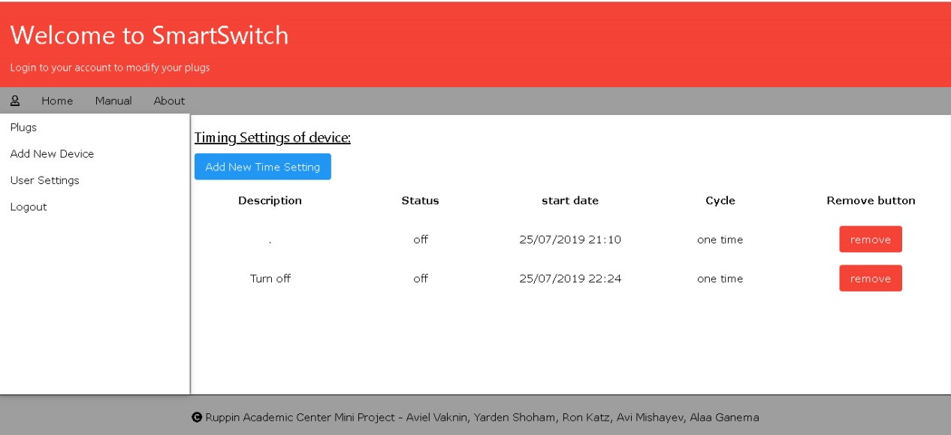
Timing Settings

Slide 8
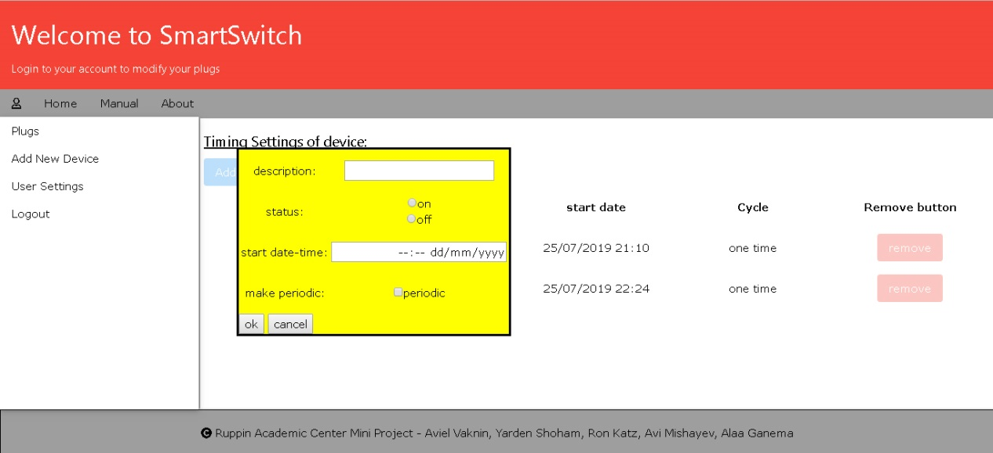
Timing Settings

Slide 9
Timing Settings
Page elements and functionalities:
Present the current’s plug already created tasks and their settings:
Task description
Status(on or off)
Start-date of the task
Task cycle(periodic or non periodic)
A “remove” button, which removes the task from the chosen plug, removes the task from the database and updates the page accordingly
A “Add New Timing Setting” button, which presents the create task popup
Using said popup, the client determines the settings of the new task
Conveying the client’s choices to the database and updating the page accordingly by clicking the “ok” button from the popup
Removing the popup by clicking on the “cancel” button ,which is located on said popup

